Slide 1
Software Quality
Lecture 1

Slide 2
SDLC
A framework that describes the activities performed at each stage of a software development project.

Slide 3
Six Phases of the System Development Life Cycle
Preliminary Investigation
  Assesses feasibility and practicality of system
System Analysis
  Study old system and identify new requirements
  Defines system from user's view
System Design
  Design new/alternative system
  Defines system from technical view

Slide 4
Six Phases of the System Development Life Cycle
System Development
  New hardware and software is acquired, developed, and tested
System Implementation
  System installation and training
System Operation & Maintenance
  Daily operation
  Periodic evaluation and updating

Slide 5
Quality professional view:
  – Conformance to requirement(Crosby, 1979)
  – Fitness for use (Juran, 1970)
    The requirements are clearly stated and the product must conform to it
    Any deviation from the requirements is regarded as a defect
    A good quality product contains fewer defects
    Fit to user expectations: meet user’s needs
    A good quality product provides better user satisfaction

Slide 6
What is quality ?
What you see of high quality others do not see it like that.
It depends on the systems requirements.
For example a university perfect registration system is not necessarily suitable to a school.

Slide 7
IEEE Definition of
"Software Quality"
The degree to which a system, component, or process meets specified requirements.
The degree to which a system, component, or process meets customer or user needs or expectations.
Notes:
What about non-specified requirements?

Slide 8
ISO Definition of Quality
The totality of features and characteristics of a product or a service that bear on its ability to satisfy stated or implied needs

Slide 9
Software Quality Assurance
A planned and systematic pattern of all actions necessary to provide adequate confidence that an item or product conforms to established technical requirements.
A set of activities designed to evaluate the process by which the products are developed or manufactured.

Slide 10
Prevention Versus Detection
Detection :
- Identify
- Correct
Prevention
  Train
  Do it right from the first time

Slide 11
Software quality assurance vs. software quality control
Quality Control = activities designed to evaluate the quality of a product
Quality Assurance = activities to prevent and correct errors of a product.
The main objective of quality assurance is to minimize the cost of guaranteeing quality by a variety of activities performed throughout the development and manufacturing processes/stages.

Slide 12
QA vs. QC
Quality Assurance makes sure that we are doing the right things, the right Way.
QA focuses on building in quality and hence preventing defects.
QA deals with process.
QA is for entire life cycle.
QA is preventive process.
Quality Control makes sure the results of what we’ve done are what we expected .
QC focuses on testing for quality and hence detecting defects.
QC deals with product.
QC is for testing part in SDLC.
QC is corrective process.

Slide 13
software errors, software faults and software failures.
Software errors are sections of the code that are partially or totally incorrect as a result of a grammatical, logical or other mistake made by a systems analyst, a programmer, or another member of the software development team.
Software faults are software errors that cause the incorrect functioning of the software during a specific application.
Software faults become software failures only when they are “activated”, that is, when a user tries to apply the specific software section that is faulty. Thus, the root of any software failure is a software error.

Slide 14
SQA Activities Objective
Assuring an acceptable level of confidence that the software and its maintenance activities will conform to functional technical requirements.
conform to managerial scheduling and budgetary requirements.
Initiating and managing of activities for the improvement and greater efficiency of software development and SQA activities.

Slide 15
Types of errors
    Code error
    Procedure error
    Documentation error
    Software data error etc..

Slide 16
Causes of software errors
faulty requirements definition
client-developer communication failures
deliberate deviations from software requirements
logical design errors
coding errors
non-compliance with documentation and coding instructions
shortcomings of the testing process
procedure errors
documentation errors

Slide 17
Cost of Errors
"Software bugs, or errors, are so prevalent and so detrimental that they cost the U.S. economy an estimated $59.5 billion annually, or about 0.6 percent of the gross domestic product."
US Dept of Commerce
June 2002

Slide 18
A Collection of Well-Known Software Failures
Therac-25
Patriot Missile System
NASA's Mars Polar Lander
ESA's Ariane 5 Launch System
Knight Capital's $440 million loss
Microsoft Zune's New Year Crash
Air-Traffic Control System in LA Airport
from www.wikipedia.org

Slide 19
Northeast Blackout
NASA Mars Climate Orbiter
Denver Airport Baggage-handling System
Therac-25
USS Yorktown Incident
Ariane 5 Explosion

Slide 20
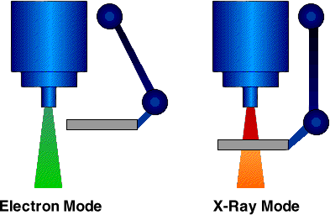
Therac-25 - the problem
When operating in soft X-ray mode, the machine was designed to rotate three components into the path of the electron beam, in order to shape and moderate the power of the beam. …
The accidents occurred when the high-energy electron-beam was activated without the target having been rotated into place; the machine's software did not detect that this had occurred, and did not therefore determine that the patient was receiving a potentially lethal dose of radiation, or prevent this from occurring.

Slide 21
Therac-25 - the reasons
The design did not have any hardware interlocks to prevent the electron-beam from operating in its high-energy mode without the target in place.
The engineer had reused software from older models. These models had hardware interlocks and were therefore not as vulnerable to the software defects.
The hardware provided no way for the software to verify that sensors were working correctly.
The equipment control task did not properly synchronize with the operator interface task, so that race conditions occurred if the operator changed the setup too quickly. This was evidently missed during testing, since it took some practice before operators were able to work quickly enough for the problem to occur.
The software set a flag variable by incrementing it. Occasionally an arithmetic overflow occurred, causing the software to bypass safety checks.

Slide 22

Patriot Missile System
On February 25, 1991, the Patriot missile battery at Dharan, Saudi Arabia had been in operation for 100 hours, by which time the system's internal clock had drifted by one third of a second. For a target moving as fast as an inbound TBM, this was equivalent to a position error of 600 meters.
The radar system had successfully detected the Scud and predicted where to look for it next, but because of the time error, looked in the wrong part of the sky and found no missile. With no missile, the initial detection was assumed to be a spurious track and the missile was removed from the system. No interception was attempted, and the missile impacted on a barracks killing 28 soldiers.

Slide 23
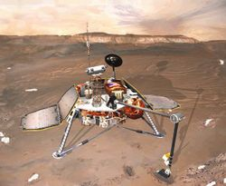
Mars Polar Lander
The last telemetry from Mars Polar Lander was sent just prior to atmospheric entry on December 3, 1999. No further signals have been received from the lander. The cause of this loss of communication is unknown.
According to the investigation that followed, the most likely cause of the failure of the mission was a software error that mistakenly identified the vibration caused by the deployment of the lander's legs as being caused by the vehicle touching down on the Martian surface, resulting in the vehicle's descent engines being cut off whilst it was still 40 meters above the surface, rather than on touchdown as planned.
Another possible reason for failure was inadequate preheating of catalysis beds for the pulsing rocket thrusters

Slide 24

Ariane 5 Rocket
June 4, 1996 was the first test flight of the Ariane 5 launch system. The rocket tore itself apart 37 seconds after launch, making the fault one of the most expensive computer bugs in history.
The Ariane 5 software reused the specifications from the Ariane 4, but the Ariane 5's flight path was considerably different and beyond the range for which the reused code had been designed. Specifically, the Ariane 5's greater acceleration caused the back-up and primary inertial guidance computers to crash, after which the launcher's nozzles were directed by spurious data. Pre-flight tests had never been performed on the re-alignment code under simulated Ariane 5 flight conditions, so the error was not discovered before launch.
Because of the different flight path, a data conversion from a 64-bit floating point to 16-bit signed integer caused a hardware exception (more specifically, an arithmetic overflow, as the floating point number had a value too large to be represented by a 16-bit signed integer). Efficiency considerations had led to the disabling of the exception handler for this error. This led to a cascade of problems, culminating in destruction of the entire flight.

Slide 25
Denver International Airport
The opening of the new Denver International Airport (DIA) in February 1995 was a day of celebration for Colorado citizens but it was certainly the end of a traumatic period for the information technology industry. DIA was planned to be the largest airport in the United States, to serve 110 000 000 passengers annually by 2020, to handle 1750 flights daily through 200 gates and 12 operating runways. Operations at DIA were delayed by 16 months, mainly due to the failure of the software-based baggage handling system, causing estimated total losses of $2 billion. Moreover, the baggage handling system finally

Slide 26
Denver International Airport
put into service was substantially downscaled in comparison to the system originally specified. Although several other colossal failures of software systems unfortunately have been recorded since 1995, the failure of IT technology at DIA was especially traumatic to the profession, whether due to the scale of the losses or the public interest and criticism it raised. Many SQA professionals, including the author, believe that had appropriate software quality assurance systems been applied to the project at its start, a failure of this scale would not have occurred or, at least, its losses would have been dramatically reduced.

Slide 27
Capability Maturity Model Integration (CMMI)
The Capability Maturity Model Integration, or CMMI, is a process model that provides a clear definition of what an organization should do to promote behaviors that lead to improved performance.
With five “Maturity Levels” or three “Capability Levels,” the CMMI defines the most important elements that are required to build great products, or deliver great services, and wraps them all up in a comprehensive model.

Slide 28
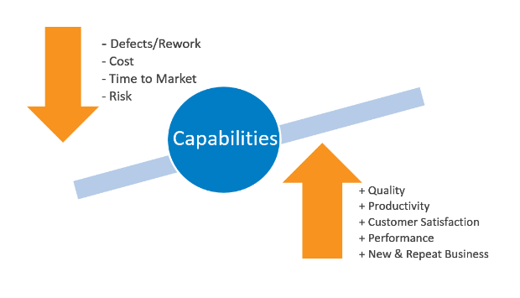
Capability Maturity Model Integration (CMMI) is a process level improvement training and appraisal program.
Administered by the CMMI Institute, a subsidiary of ISACA, it was developed at Carnegie Mellon University (CMU).

Slide 29
An organization cannot be certified in CMMI; instead, an organization is appraised using SCAMPI method.
Appraisals of organizations using a CMMI model must conform to the requirements defined in the Appraisal Requirements for CMMI (ARC) document.
The Standard CMMI Appraisal Method for Process Improvement (SCAMPI) is an appraisal method that meets all of the ARC requirements
Depending on the type of appraisal, the organization can be awarded a maturity level rating (1-5) or a capability level achievement profile.

Slide 30
Results of a SCAMPI appraisal may be published (if the appraised organization approves) on the CMMI Web site of the SEI:
https://sas.cmmiinstitute.com/pars/
CMMI in Bangladesh: https://sas.cmmiinstitute.com/pars/pars.aspx

Slide 31
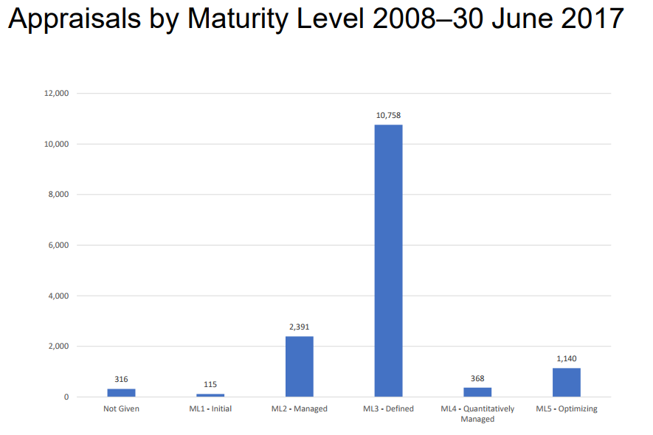


Slide 32
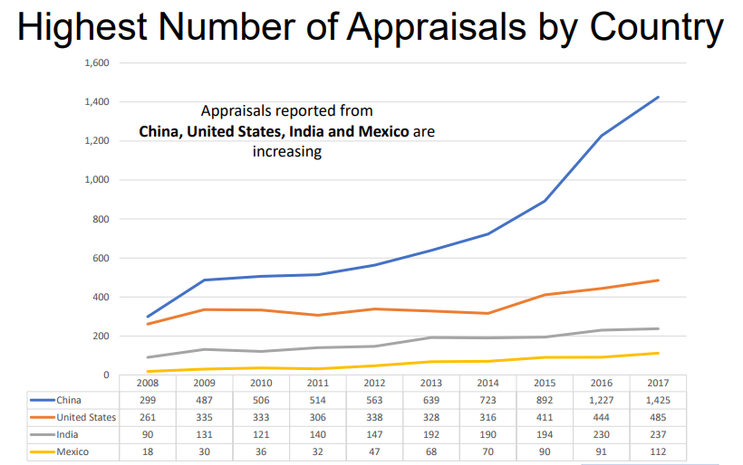

Slide 33
Capability Maturity Model Integration (CMMI) : BANGLADESH (July, 2017)
Level 5:
  DataSoft Systems Bangladesh Ltd.
  Leadsoft Bangladesh Limited, Dhaka
  Southtech Limited
Level 3:
  BJIT
  Computer Network Systems Limited
  Computer Source Info Tech Limited
  Data Edge Limited
  Dohatec New Media
  Ethics Advanced Technology Limited
  Grameen Solutions Ltd.
  IBCS- PRIMAX Software (Bangladesh) Ltd.
  Spectrum Engineering Consortium Ltd.
  Star Computer Systems Limited
  Technohaven Company Ltd.
  TechnoVista Limited
Source: https://sas.cmmiinstitute.com/pars/pars.aspx

Slide 34
Summary of appraisal of July 2017:
  Appraisals increased 14% 1 Jan – 30 Jun 17
  Appraisals reported from China, United States, India and Mexico are increasing
  The number of appraised organizations using agile methods has grown to more than 80%

Slide 35
CMMI Levels
Maturity Level 1- Initial
  At maturity level 1, processes are usually ad hoc and chaotic. The organization usually does not provide a stable environment.
  Success in these organizations depends on the competence and heroics of the people in the organization and not on the use of proven processes.
Maturity Level 2 – Managed
  The process discipline reflected by maturity level 2 helps to ensure that existing practices are retained during times of stress. When these practices are in place, projects are performed and managed according to their documented plans.

Slide 36
CMMI Levels
  At maturity level 2, requirements, processes, work products, and services are managed. The status of the work products and the delivery of services are visible to management at defined points.
  Key criteria's:
  CM - Configuration Management
  MA - Measurement and Analysis
  PPQA - Process and Product Quality Assurance
  REQM - Requirements Management
  SAM - Supplier Agreement Management
  SD - Service Delivery
  WMC - Work Monitoring and Control
  WP - Work Planning

Slide 37
Maturity Level 3 – Defined
  At maturity level 3, processes are well characterized and understood, and are described in standards, procedures, tools, and methods.
  A critical distinction between maturity level 2 and maturity level 3 is the scope of standards, process descriptions, and procedures. At maturity level 2, the standards, process descriptions, and procedures may be quite different in each specific instance of the process (for example, on a particular project). At maturity level 3, the standards, process descriptions, and procedures for a project are tailored from the organization's set of standard processes to suit a particular project or organizational unit.

Slide 38
  Key criteria’s of level 3:
CAM - Capacity and Availability Management
DAR - Decision Analysis and Resolution
IRP - Incident Resolution and Prevention
IWM - Integrated Work Managements
OPD - Organizational Process Definition
OPF - Organizational Process Focus
OT - Organizational Training
RSKM - Risk Management
SCON - Service Continuity
SSD - Service System Development
SST - Service System Transition
STSM - Strategic Service Management

Slide 39
Maturity Level 4 - Quantitatively Managed
  A critical distinction between maturity level 3 and maturity level 4 is the predictability of process performance. At maturity level 4, the performance of processes is controlled using statistical and other quantitative techniques, and is quantitatively predictable. At maturity level 3, processes are only qualitatively predictable.
  Key criteria’s:
  OPP - Organizational Process Performance
  QWM - Quantitative Work Management

Slide 40
Maturity Level 5 – Optimizing
Maturity level 5 focuses on continually improving process performance through both incremental and innovative technological improvements.
The organization's ability to rapidly respond to changes and opportunities is enhanced by finding ways to accelerate and share learning. Improvement of the processes is inherently part of everybody's role, resulting in a cycle of continual improvement.

Slide 41
  A critical distinction between maturity level 4 and maturity level 5 is the type of process variation addressed. At maturity level 4, processes are concerned with addressing special causes of process variation and providing statistical predictability of the results. Though processes may produce predictable results, the results may be insufficient to achieve the established objectives. At maturity level 5, processes are concerned with addressing common causes of process variation and changing the process (that is, shifting the mean of the process performance) to improve process performance (while maintaining statistical predictability) to achieve the established quantitative process-improvement objectives.
  Key criteria’s:
  CAR - Causal Analysis and Resolution
  OPM - Organizational Performance Management.

Slide 42
5 Focus on continuous process improvement
Optimizing
4 Process measured and controlled
Quantitatively Managed
3 Process characterized for the organization and is proactive
Defined
2 Process characterized for process and is often reactive
Managed
Initial
1 Process unpredictable, poorly controlled and reactive

Slide 43
Quality Factors

Slide 44
ISO 9126 Software Quality Factors
Functionality
Reliability
Usability
Efficiency
Maintainability
Portability

Slide 45
McCall’s Quality Factors
McCall has 11 factors; Groups them into categories.
  1977; others have added, but this still prevail.
Three categories:
  Product Operation Factors
    How well it runs….
    Correctness, reliability, efficiency, integrity, and usability
  Product Revision Factors
    How well it can be changed, tested, and redeployed.
    Maintainability; flexibility; testability
  Product Transition Factors
    How well it can be moved to different platforms and interface with other systems
    Portability; Reusability; Interoperability

Slide 46
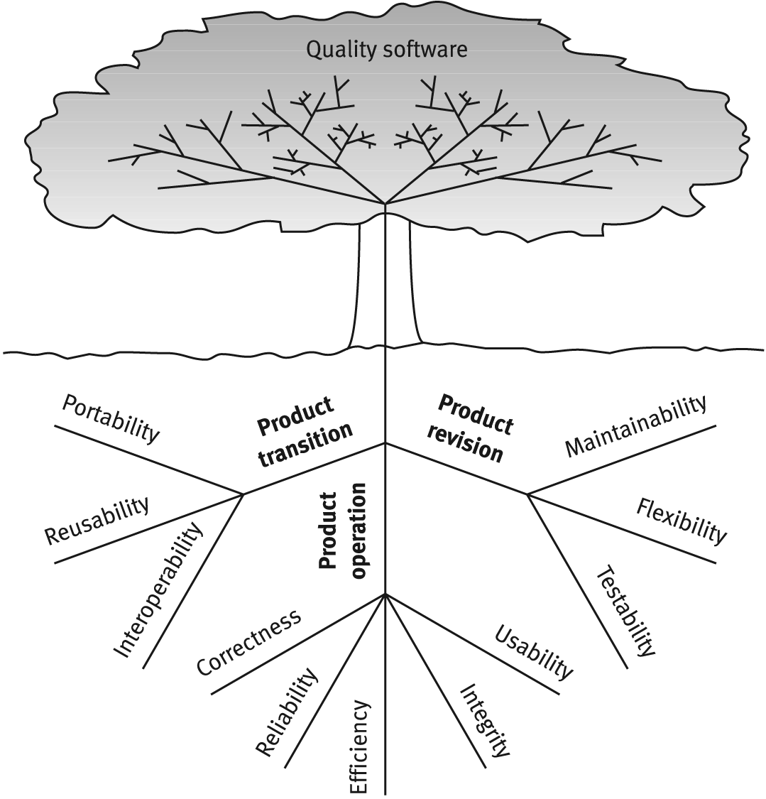
McCalls factor model tree

Slide 47
Product operation factors
Correctness
Reliability
Efficiency
Integrity
Usability
How well does it run and ease of use.

Slide 48
1. Correctness.
‘correctness’ issues are arising from the requirements documentation and the specification of the outputs
Examples include:
  Specifying accuracies for correct outputs at, say, NLT <1% errors, that could be affected by inaccurate data or faulty calculations;
  Specifying the completeness of the outputs provided, which can be impacted by incomplete data (often done)
  Specifying the timeliness of the output (time between event and its consideration by the software system)
  Specifying the standards for coding and documenting the software system we have talked about this: standards and integration; Essential!!

Slide 49
2. Reliability Requirements
Reliability requirements deal with the failure to provide service.
  Address failure rates either overall or to required functions.
Example :
  A heart monitoring system must have a failure rate of less than one per million cases.
  Downtime for a system will not be more than ten minutes per month (me)
  MTBF and MTTR - old and engineering, but still applicable.
3. Efficiency Requirements.
Deals with the hardware resources needed to perform the functions of the software.
  Here we consider MIPS, MHz (cycles per second); data storage capabilities measured in MB or TB; communication lines (usually measured in KBPS, MBPS, or GBPS).

Slide 50
4. Integrity –
deal with system security that prevent unauthorized persons access.
Example: Cyber Security; Internet security; network security, and more.
5. Usability Requirements –
deals with the scope of staff resources needed to train new employees and to operate the software system.
  Deals with learnability, utility, usability, and more.
  Example spec: A staff member should be able to process n transactions / unit time

Slide 51
Product revision factors
Maintainability
Flexibility
Testability
Can I fix it easily, retest, version it, and deploy it easily?

Slide 52
1. Maintainability Requirements
  The degree of effort needed to identify reasons (find the problem) for software failure and to correct failures and to verify the success of the corrections.
  Example specs: Refactor so the size of module <= 30 statements.
2. Flexibility Requirements
deals with resources to change (adopt) software to different types of customers that use the app perhaps a little differently;
  May also involve a little perfective maintenance to perhaps do a little better due to the customer’s perhaps slightly more robust environment.

Slide 53
  3. Testability Requirements
  Are intermediate results of computations predefined to assist testing?
  Are log files created? Backup?
  Does the software diagnose itself prior to and perhaps during operations?

Slide 54
Product transition factors
Portability
Reusability
Interoperability
Can I move the app to different hardware?
Interface easily with different hardware / software systems; can I reuse major portions of the code
with little modification to develop new apps?

Slide 55
1. Portability Requirements:
If the software must be ported to different environments (different hardware, operating systems, …) and still maintain an existing environment, then portability is a must.
2. Reusability Requirements: Are we able to reuse parts of the app for new applications?
  Can save immense development costs due to errors found / tested.
  Certainly higher quality software and development more quickly results.
  Very big deal nowadays.

Slide 56
3. Interoperability Requirements:
Does the application need to interface with other existing systems
  Frequently these will be known ahead of time and plans can be made to provide for this requirement during design time.
    Sometimes these systems can be quite different; different platforms, different databases, and more
  Also, industry or standard application structures in areas can be specified as requirements.

Slide 57
IEEE 982 Nine Classes of Measures
Product Measures
  errors, faults, failures
  mean-time-to-failure
  reliability growth and projection
  remaining products faults
  completeness and consistency
  Complexity
Process Measures
  management control
  coverage
  risk, benefit, cost evaluation

Slide 58
More Info on Quality Metrics
  IEEE 982
    particularly interesting
      section 4
      appendices
  National Institute for Standards and Technology
  NASA Quality Factors

